Slide 1
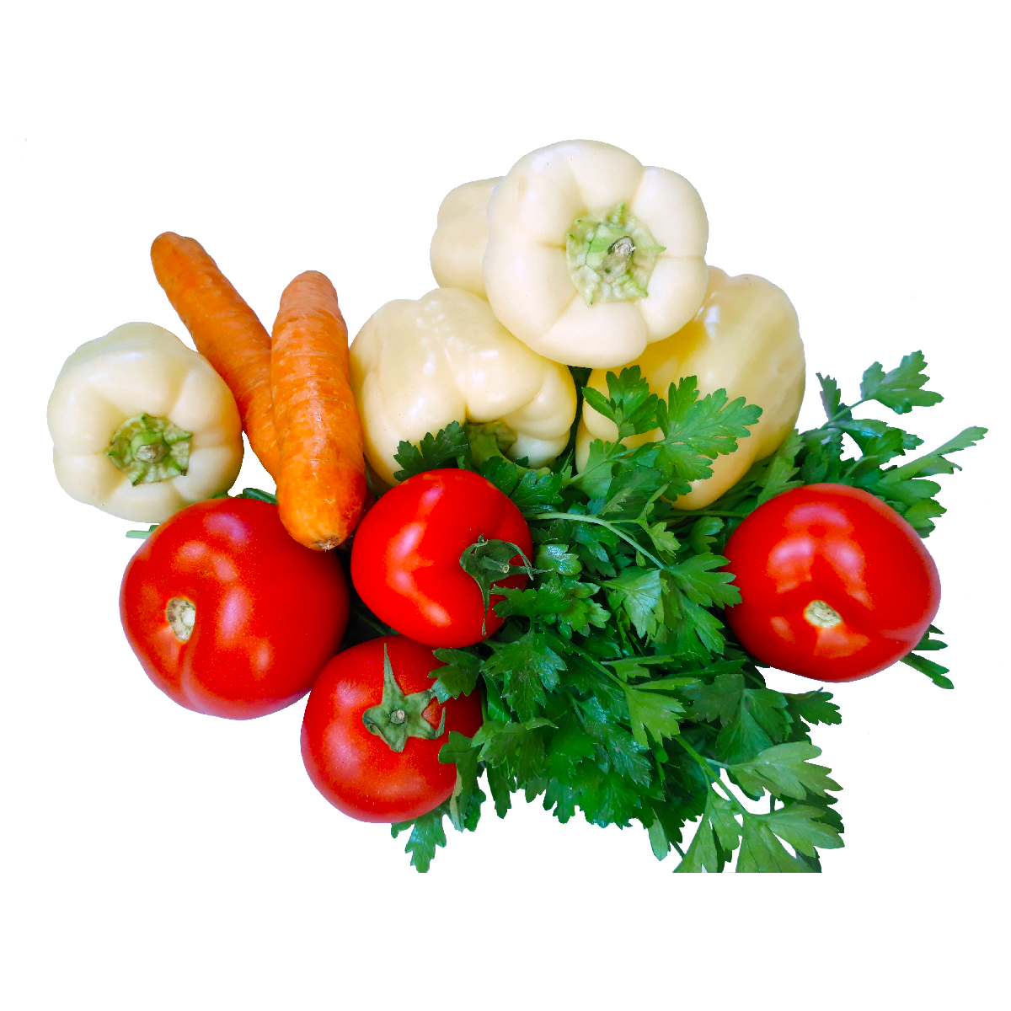
Title:Vegetables
Description: Vegetables are essential, nutrient-dense foods that come in a variety of colors, shapes, and flavors. They provide vital vitamins, minerals, fiber, and antioxidants that support overall health. Commonly consumed raw, cooked, or juiced, vegetables play a crucial role in a balanced diet.

Slide 2
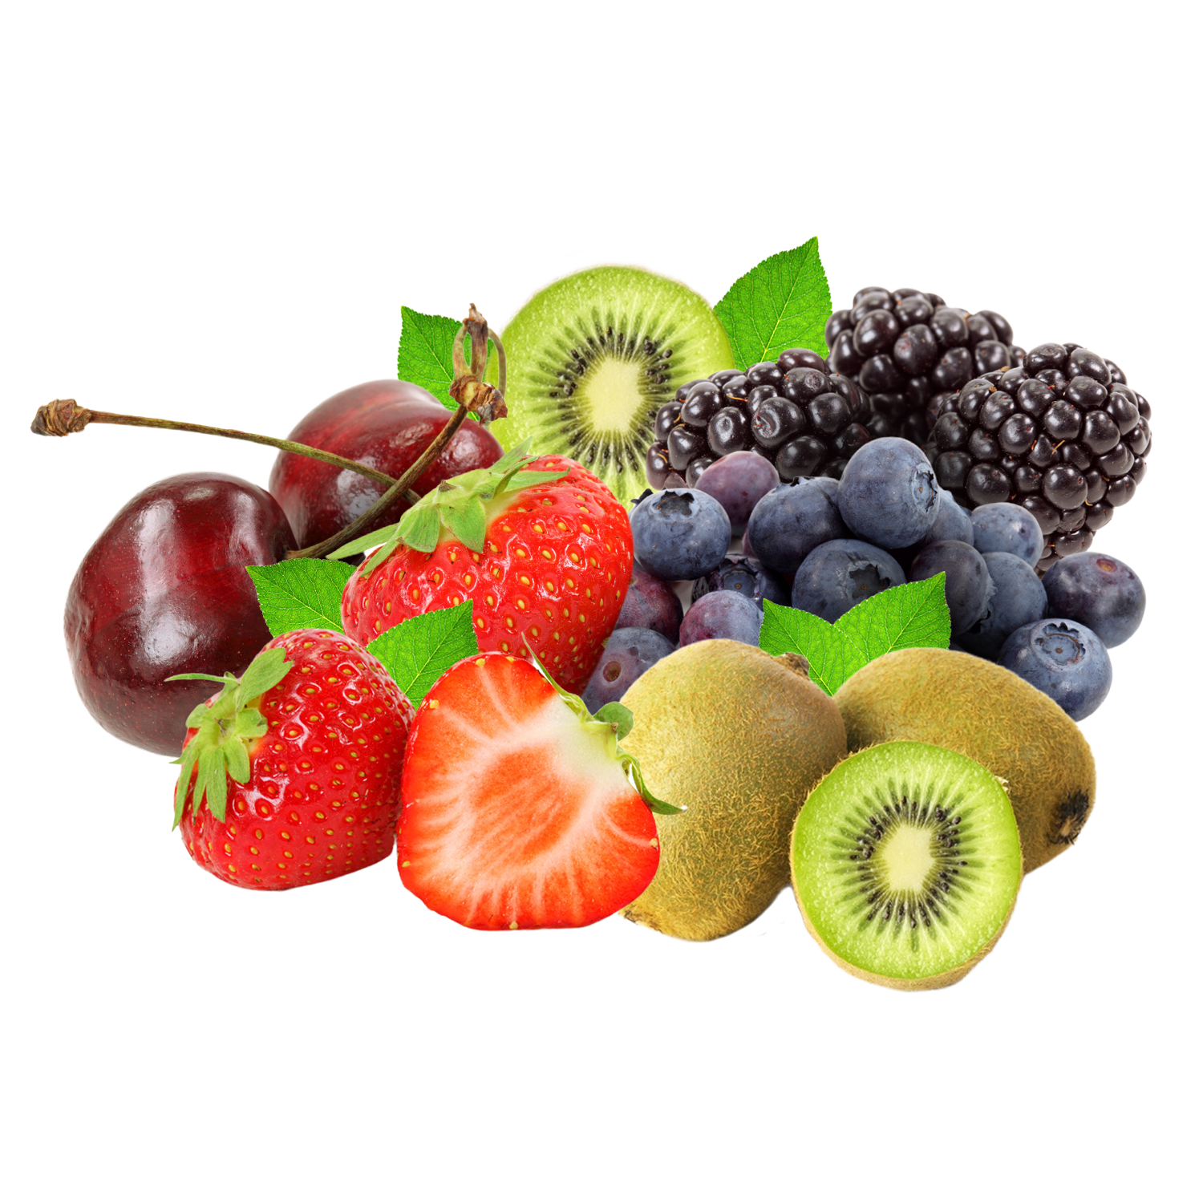
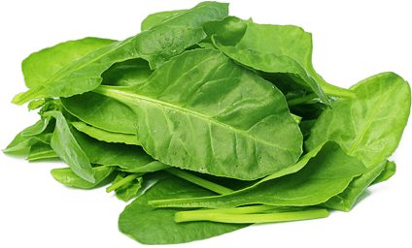
textbox

